Slide 1

Year 6
Mrs Barnard, Miss Bertorelli & Mrs Adams

Slide 2

Included in this presentation:
Curriculum overview
Curriculum expectations for Reading
Curriculum expectations for Writing
Curriculum expectations for Maths
Home Learning
Spelling and Reading
SATS (standardised tests)
Enrichment in Year 6

Slide 3
Curriculum

Slide 4
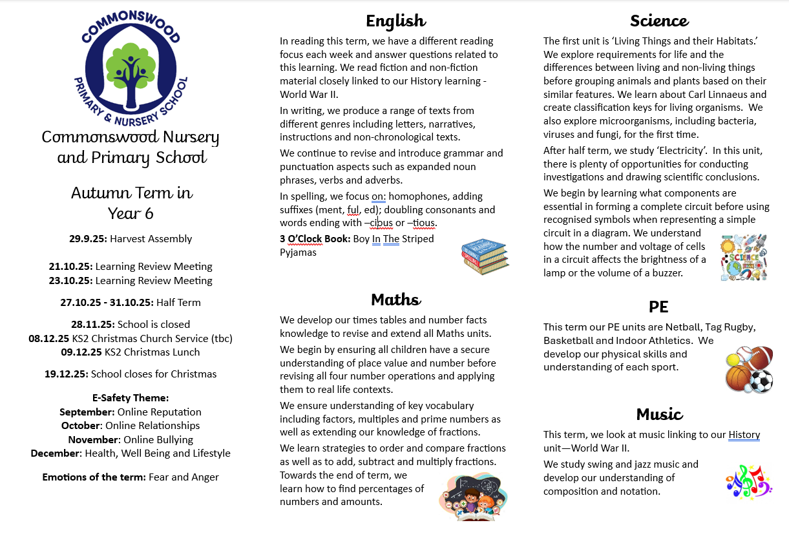

Slide 5


Slide 6

Curriculum expectation of Year 6 -Writing
By the end of Year 6, to be age related your child needs to be able to:
The pupil can: •
write effectively for a range of purposes and audiences, selecting language that shows good awareness of the reader (e.g. the use of the first person in a diary; direct address in instructions and persuasive writing) •
in narratives, describe settings, characters and atmosphere
integrate dialogue in narratives to convey character and advance the action
select vocabulary and grammatical structures that reflect what the writing requires, doing this mostly appropriately (e.g. using contracted forms in dialogues in narrative; using passive verbs to affect how information is presented; using modal verbs to suggest degrees of possibility) •

Slide 7
Curriculum expectation of Year 6- Writing
use a range of devices to build cohesion (e.g. conjunctions, adverbials of time and place, pronouns, synonyms) within and across paragraphs
•
use verb tenses consistently and correctly throughout their writing • use the range of punctuation taught at key stage 2 mostly correctly^ (e.g. inverted commas and other punctuation to indicate direct speech) •
spell correctly most words from the year 5 / year 6 spelling list,* and use a dictionary to check the spelling of uncommon or more ambitious vocabulary •
maintain legibility in joined handwriting when writing at speed.2

Slide 8
Expectations of handwriting
Your child may have begun to write with pen in their books. To move from pencil to pen your child needs to:
Correctly form all of their letters with cursive links.
Have consistently joined letters in all books.
Show consistent letter size.
Maintain neat handwriting in all books.
Should your child move to pen but then not maintain their joined letters after a few attempts, in discussion with the teacher they will use pencil again for a while.
This is because a pencil does offer better friction on the page for the child to practice their joining.
Once consistent again, your child will move back to use pen.
These expectations are there as at the end of KS2 for your child to be expected
in writing, they must maintain legibility in joined handwriting when writing at speed.

Slide 9

Curriculum expectation of Year 6 - Maths
By the end of Year 6, to be age related your child needs to be able to be confident in and apply Maths skills to word/reasoning problems in these topics:
Number and Place Value
Addition and Subtraction
Multiplication and Division
Fractions, Decimals and Percentages
Measurement and Time
Geometry shape and position
Ratio and Proportion
Algebra
Statistics

Slide 10

Curriculum expectation of Year 6- Reading
By the end of Year 6, to be age related your child needs to be able to:
to read fluently with full knowledge of all Y5/Y6 exception words, root words, prefixes, suffixes/word endings (as listed in English Appendix 1*) and decode any unfamiliar words with increasing speed and skill, recognising their meaning through contextual cues.
to maintain positive attitudes to reading and understanding of what they read by:
• when reading out loud, adapting intonation, tone and volume to suit the purpose and audience;
• making comparisons within and across books;
• reading a wide range of genres with different structures and purposes for pleasure, identifying themes and conventions between text types.

Slide 11
Curriculum expectation of Year 6 - Reading
to understand what they read by:
• explaining how language (including figurative language), structure and presentation can contribute to the meaning of a text;
• asking questions about a text;
• drawing inferences and inferring characters’ feelings, thoughts and motives from their actions and justifying inferences with evidence;
• making predictions based on details stated and implied with evidence from the text.
to distinguish independently between statements of fact and opinion.
to retrieve, record and present information from texts to other readers in informal notes and formal presentations.
to participate in discussions about books that are read to them and those they can read for themselves.

Slide 12
Homework
Set on a Friday and returned on a Tuesday.
The homework will be a maths, literacy or subject based piece of learning. This will either be pre-learning or consolidation of learning from the week.
Spelling words will be stuck into their home learning and reading record books.
It should take your child no longer than 20 minutes to complete, unless more time is given for example in a bigger project.
If your child is finding an element of the homework tricky, they have Monday to ask questions before it is handed in (a model will be given).

Slide 13
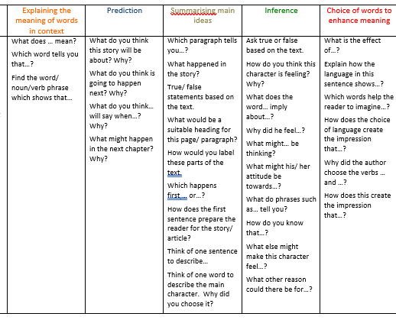
Spellings and Reading
Please practise the spellings set each week. They are set on a Friday and tested on the following Thursday.
Please read with your child every evening and record this in their reading record. Please try to focus any questioning on the Guided reading focus that week by using the question stems at the front of the reading record.

Slide 14
End of KS2 standardised assessment
(SATs)

Slide 15
WHAT WILL BE ASSESSED?
ASSESSED BY TESTS (marked externally)
READING
GPS
MATHS
ONE PAPER
Reading booklet and associated answer booklet.
TWO PAPERS
Paper 1, short answer questions.
Paper 2, spelling.
THREE PAPERs
Paper 1, arithmetic
Paper 2, reasoning
Paper 3, reasoning
CONTINUOUS TEACHER ASSESSMENT
WRITING
SATs week across the country begins on
Monday 11th May 2026.

Slide 16
Grammar, Punctuation and Spelling (GPS)
A spelling test, administered verbally by the teacher, contains 20 words.
A separate test is given on grammar, punctuation and vocabulary
This test lasts for 45 minutes and requires short answer questions including some multiple choice.
Marks for these two tests are added together to give a total for GPS.

Slide 17
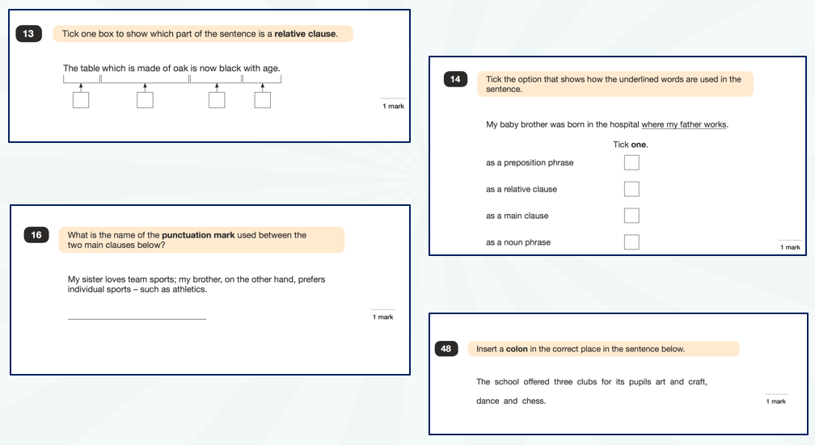
GPS example questions

Slide 18
Reading
The reading test consists of a single test paper with three unrelated reading texts of different genres. Children are given 60 minutes in total, which includes reading the texts and answering the questions.
A total of 50 marks are available.
Questions are designed to assess the skills and comprehension of a child’s reading.
During the reading paper, a child’s inference and deduction skills are thoroughly tested. They will have to explain why an author has chosen to use particular vocabulary, grammar and text features.
Some questions are multiple choice or selected response (1 mark); others require short answers (1-2 marks) and some require an extended response or explanation (2-3 marks).

Slide 19
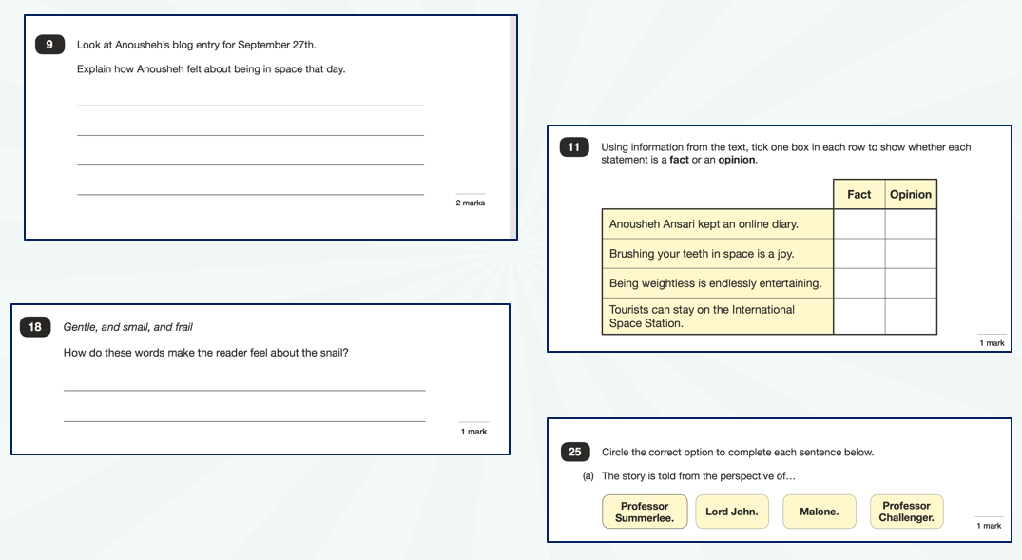
Reading – sample questions

Slide 20
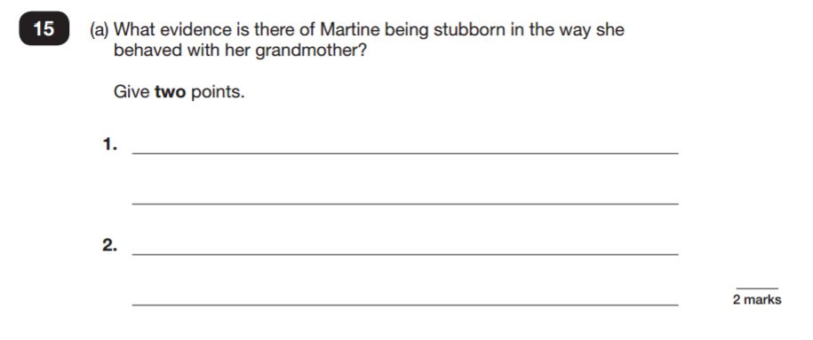
Reading – sample questions
Reading Paper

Slide 21
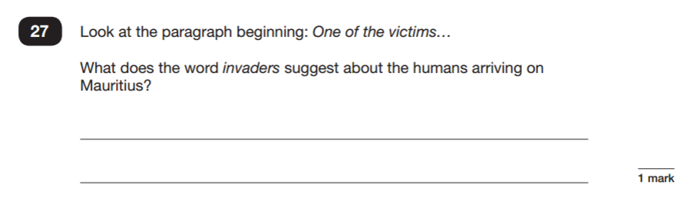
Reading Paper

Slide 22
Mathematics
Children will sit three tests: paper 1, paper 2 and paper 3.
Paper 1 is Arithmetic lasting for 30 minutes, covering calculation methods for all operations, including use of fractions, percentages and decimals.
Papers 2 and 3 cover problem solving and reasoning, each lasting for 40 minutes.
Pupils will apply calculation skills to answer questions in context and decide what is required to find a solution.
Pupils are not allowed to use a calculator for any of these papers

Slide 23
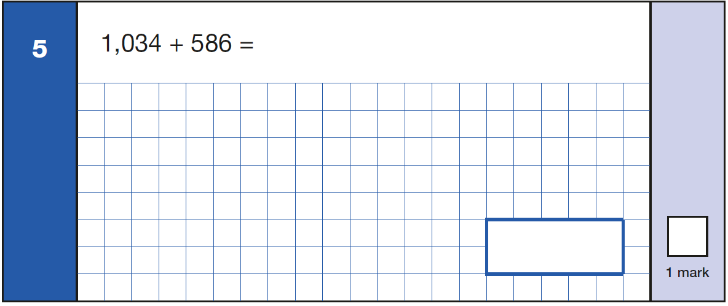
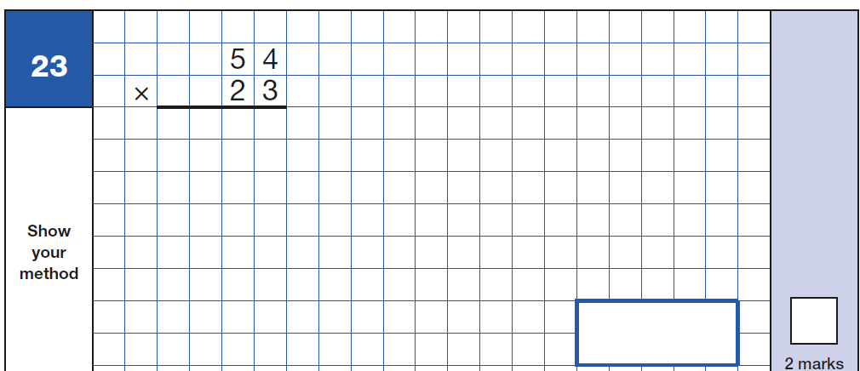
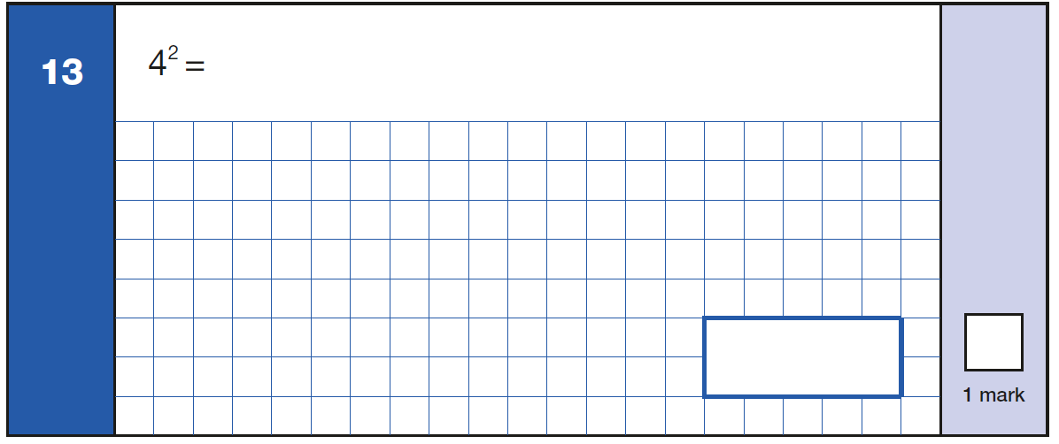
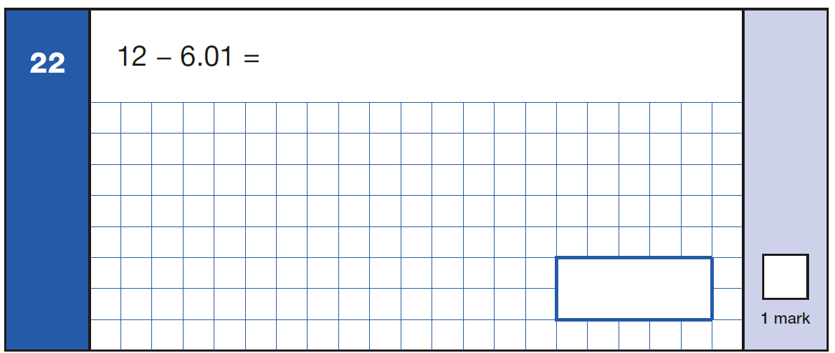
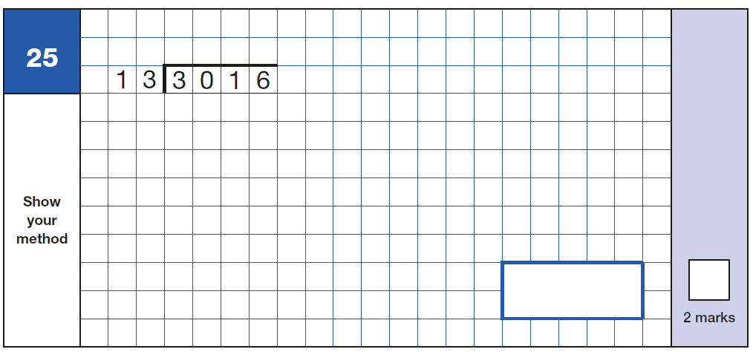
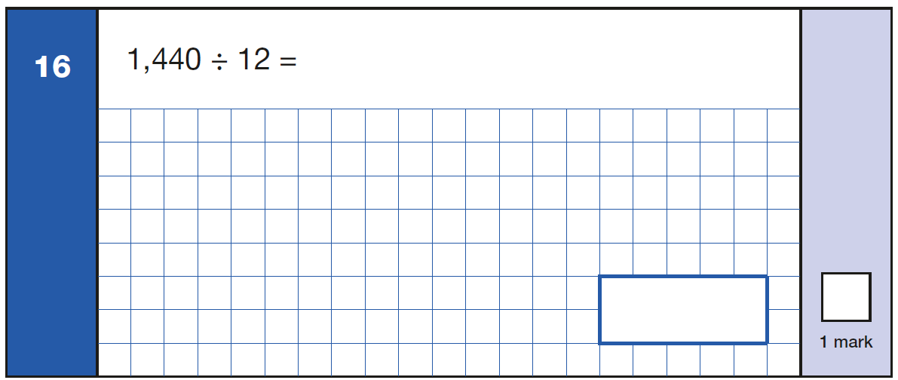
Sample arithmetic questions

Slide 24
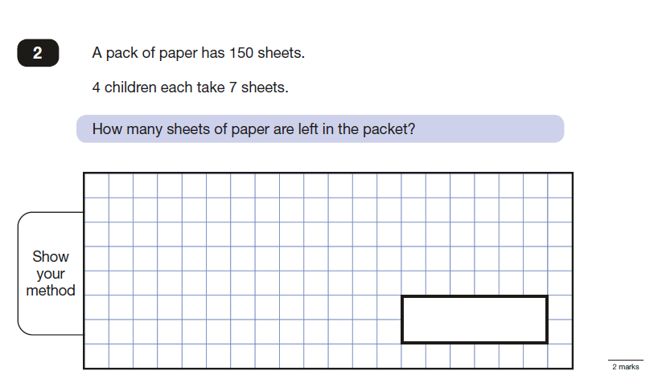
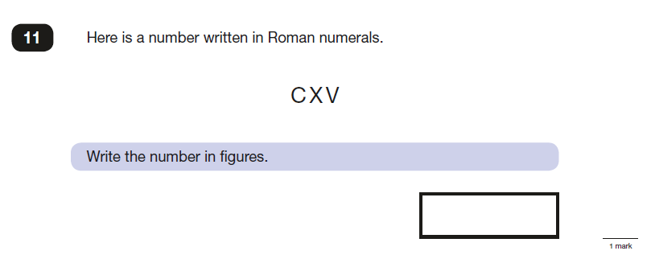
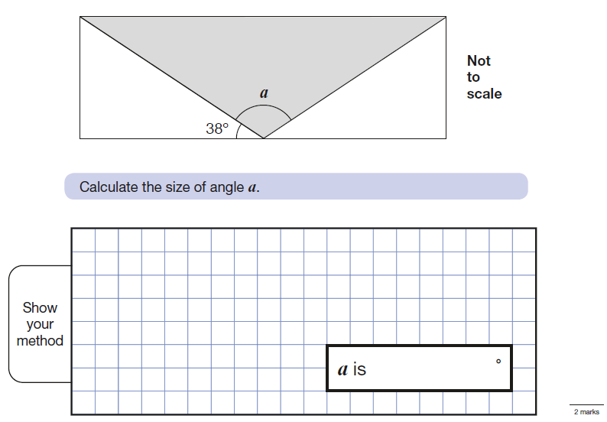
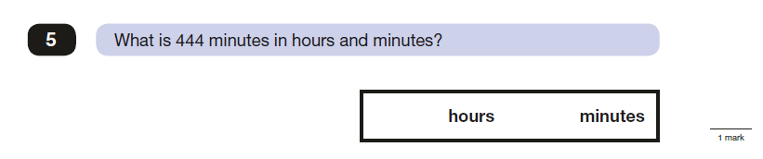
Sample reasoning questions

Slide 25
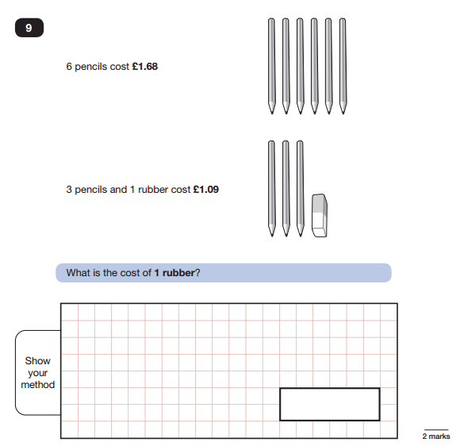
Maths Paper 2 / Paper 3 : Reasoning

Slide 26
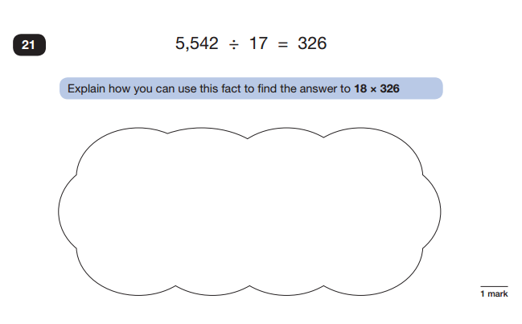
Maths Paper 2 / Paper 3 : Reasoning

Slide 27
Writing
Teachers will assess children’s writing composition. Children’s results for English writing will be a judgement of their work throughout Year 6.
Children's grammar, punctuation and spelling skills is part of the teacher assessment of writing, but their creativity and writing style (language choices) will also be evaluated.
Schools will moderate their judgements with other local schools and may be moderated by their Local Authorities too.

Slide 28
How can you help?
Support them with their homework and encourage them to use materials / websites (e.g. BBC Bitesize, Khan Academy) to help them to revise.
Times tables practise
Reading
Ensure children have sensible bedtimes and lots of sleep before the tests.
Make sure children have breakfast either at home or at school.
Ensure children arrive to school on time.
Talk to them about the tests.
No pressure! All children are encouraged to try their best.

Slide 29


Things to remember
-Reading books from school taken home need to be brought back in the condition they were sent home in and there will be a charge for lost/damaged books.
-PE kit needs to be in on a Monday and will be sent home on a Friday. Girls who wear shorts under their skirt will need another pair of shorts for PE. PE shorts must be blue.
-Please let us know of any changes that we need to be aware of – personal.

Slide 30

Things to remember…
Importance of attendance!
If your child is absent this breaks the continuity of learning and they could find it trickier to access the learning.
Support your child!
Please read everyday! Reading underpins everything that we do in school.
Outside achievements!
We love to hear about your child’s achievements outside of school, however we do not do a show and tell as this uses up valuable learning time. Your child can share this with adults and their friends during the day.

Slide 31
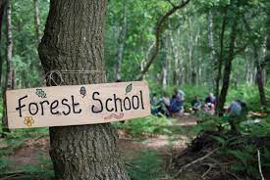
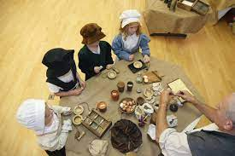
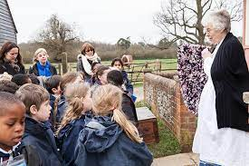
Enrichment Reminder
Enrichment opportunities coming up!
Autumn Term
RAF Hendon trip (Monday 20th October)
Orchard – Forest school learning days
Wanderlust
Buddies
Spring Term
Orchard - Forest school learning days.
Wanderlust
Buddies
Summer Term
PGL (29th June – 3rd July)
Orchard – Forest school learning days
Play
End of year trip (TBC)
We cook with your child throughout the year – please can your child have a
fabric school uniform apron to wear while cooking – this will be Autumn 2.
Information about this will be sent out.

Slide 32
We will organise an additional meeting in Spring 2 to discuss PGL and SATs in more detail.

Slide 33

Mobile phones
Notes:
Police encourage children NOT to bring phone to and from school – makes them a target for muggings
Adults responsibility to check and monitor phones at home 1. You pay the bill 2. Social media apps have age restrictions for a reason therefore it’s your responsibility to keep children safe – if not, it can be seen as neglect
Children are responsible for any messages sent by their phone number – they cannot say it was an older sibling

Slide 34

Any questions…?

