Slide 1

Year 5
Mrs Hawes and Miss Grant

Slide 2

Included in this presentation:
Curriculum and expectations
How you can help at home/home learning
Spellings and reading
Enrichment in Year 5
Things you need/reminders

Slide 3
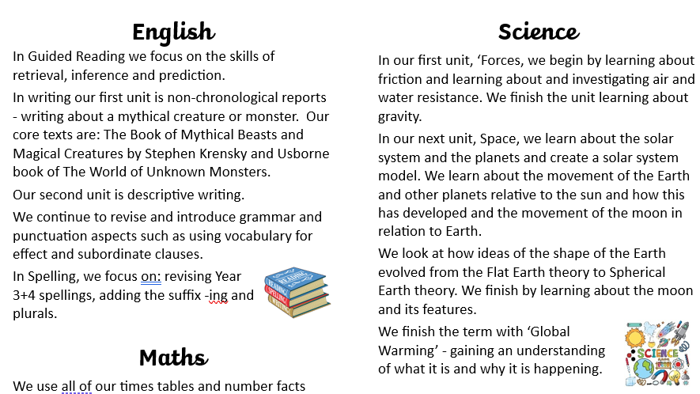
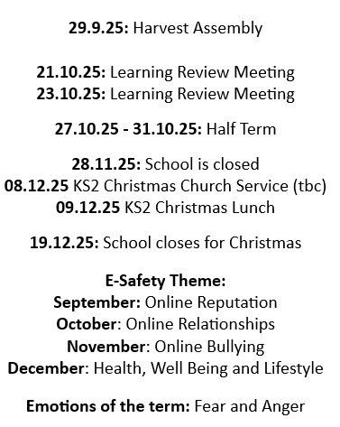

More information about our curriculum can be found on the school website

Slide 4
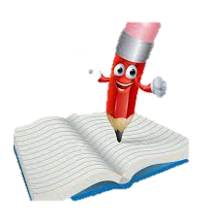
Curriculum expectation of Year 5 -Writing
By the end of Year 5, to be age related, your child needs to be able to:
write for a range of purposes and audiences,
in narratives, describe settings, characters and atmosphere†
begin to convey character and advance the action through dialogue, maintaining a balance of speech and description •
select vocabulary and grammatical structures that are appropriate for the audience and purpose (e.g. correct sentence types; tenses; a range of verb forms; relative clauses)
use a range of devices to build cohesion within and across paragraphs (e.g. conjunctions; adverbials of time and place; pronouns; synonyms), in much of their writing •
use verb tenses consistently and correctly throughout most of their writing • use the range of punctuation taught up to and including Y5 mostly correctly^ (e.g. commas separating clauses; punctuation for parenthesis) •
spell correctly words from learning in previous year groups, and some words from the year 5 / year 6 spelling list,* using known spelling strategies and dictionaries to check the spelling of uncommon or more ambitious vocabulary •
write legibly, fluently and with increasing speed.

Slide 5
Expectations of handwriting
Your child may have begun to write with pen in their books. To move from pencil to pen your child needs to:
Correctly form all of their letters with cursive links.
Have consistently joined letters in all books.
Show consistent letter size.
Maintain neat handwriting in all books.
Should your child move to pen but then not maintain their joined letters after a few attempts, in discussion with the teacher they will use pencil again for a while.
This is because a pencil does offer better friction on the page for the child to practice their joining.
Once consistent again, your child will move back to use pen.
These expectations are there as at the end of KS2 for your child to be expected
in writing, they must maintain legibility in joined handwriting when writing at speed.

Slide 6

Curriculum expectation of Year 5 - Maths
By the end of Year 5, to be age related, your child needs to be able to:
read, write, order and compare numbers.
develop their skills of rounding to any degree of accuracy, estimating, predicting and checking the reasonableness of answers
identify the value of each digit in numbers to 10 000 000 and numbers with up to 3 decimal places and multiplies and divide by 10, 100 and 1000, giving answers to three decimal places
compare and order fractions, including fractions >1
recognise, describe and use number patterns and relationships to make generalisations about sequences within the whole number system •
use negative numbers in context, and calculates intervals across zero
use common multiples to express fractions in the same denomination
recall and use equivalences between simple fractions, decimals and percentages
solve number problems

Slide 7
Curriculum expectation of Year 5 - Maths
By the end of Year 5, to be age related, your child needs to be able to:
use their knowledge of the order of operations to carry out calculations involving the four operations
use estimation to check answers to calculations and determines in the context of a problem, an appropriate degree of accuracy
identify common factors, common multiples and prime numbers
perform mental calculations, including with mixed operations and large numbers
continue to use all known facts to calculate mathematical statements with increasing complexity
solve addition and subtraction problems within the fluency focus and give reasons why operations and methods are appropriate
multiply multi-digit numbers up to four digits by a two-digit number using the formal written method of long multiplication
divide numbers up to four digits by a two-digit number using the formal written methods of long and short division and interprets remainders as whole numbers, fractions, or by rounding, as appropriate for the context

Slide 8

Curriculum expectation of Year 5- Reading
By the end of Year 5, to be age related, your child needs to be able to:
read age-appropriate books with confidence and fluency (including whole novels) •
read aloud with intonation that shows understanding •
work out the meaning of words from context, checking that the text makes sense •
predict what might happen from details stated and implied •
summarise main ideas identifying key details •
retrieve information from non-fiction •
explain and discuss their understanding of what they have read, drawing inferences and justifying these with evidence •
make comparisons between the book they are reading and other books they have read •
evaluate how authors use language, beginning to consider the impact on the reader

Slide 9
Home Learning
This is set on a Friday and returned on a Tuesday.
It will be be: a Maths or English piece of learning, recapping what we have learnt in lessons.
-spelling practice
-practising multiplication tables (TTRockstars)
-reading
All to be completed using pencil.
It should take no longer than 20 minutes to complete the main task.
An example will be given with the home learning so you can see the methods we use within Year 5
If your child is finding an element of the homework tricky, do not worry. Return the homework and a teacher will help your child in school.

Slide 10
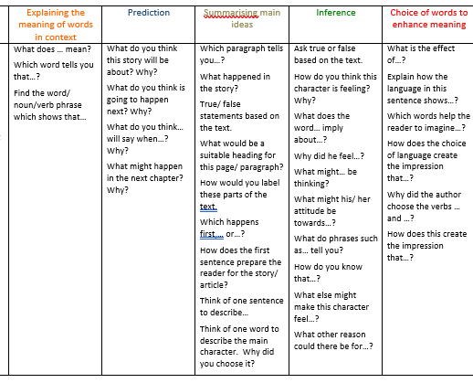
Spellings and Reading
Please practice the spellings set each week. They are set on a Friday and tested on the following Thursday. Your child will be taught these/practice them throughout the week too.
Spellings will not be tested in order.
Please read with your child every evening and record this in their reading record.
We will indicate in their reading record what our reading focus is in school. Please use this table to help with questioning at home. A copy is in their reading record.

Slide 11
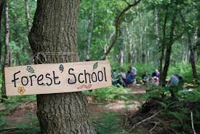
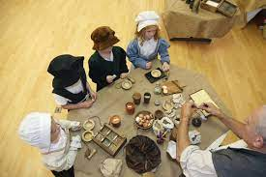
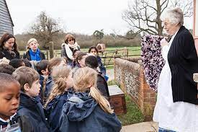
Enrichment Reminder
Enrichment opportunities coming up!
Autumn Term
Monday 13th October – Natural History Museum – understand formation of volcanoes
Spring Term
Orchard - Forest school learning days.
Summer Term
Orchard – Forest school learning days
We cook with your child throughout the year – please can your child have a
fabric school uniform apron to wear while cooking.

Slide 12

Things to remember…
Uniform -details on school website
No nail varnish
Please put names in all clothing – even coats!
Hair needs to be tied back. Earrings need to be taped or removed for PE. Plain studs only please.
A pair of wellies will be needed for time in the Orchard this year – we only have a couple of spare pairs
Please put a name in/on PE bag
PE kits need to be in school all week: Monday – Friday (our PE days are Monday and Thursday)
Girls who wear navy blue shorts under their skirt will need another pair of shorts for PE. Please make sure these shorts cannot be seen.
If you wear tights, don’t forget spare socks for PE days.

Slide 13
Things to remember…
Water bottle – named and preferable metal to avoid breaks/leaks.
Packed lunch – following guidance on website
Healthy snack – fruit / vegetables
Pencil case – can bring in a pencil, handwriting pen (no biro), ruler, rubber, sharpener, colouring pencils, and a glue. However, the school will provide what they need. If they become too big or bendy items are played with, things will be sent home.
No scissors or highlighters in pencil cases, we will provide these.
Reading book and reading record.

Slide 14
Things to remember…
Importance of attendance
If your child is absent, this breaks the continuity of learning and they could find it trickier to access the learning.
Support your child
Please read everyday! Reading underpins everything that we do in school. Little and often is the best way to do this ☺
Outside achievements
We love to hear about your child’s achievements outside of school, however we do not do a show and tell as this uses up valuable learning time. Instead, each week a child will be chosen to share a success in Friday assemblies.

Slide 15

Any questions…?
Sometimes, speaking after school on the playground is not always possible as we can have clubs or meetings. If you need a conversation with us, please email us regarding this and we will arrange this with you ☺
We are reachable via the School Office email. We will aim to respond as quickly as we can!

