Slide 1

Year 4
Magnolia: Miss Woods
Maple: Mrs White
A copy of these slides will be on the school website.

Slide 2

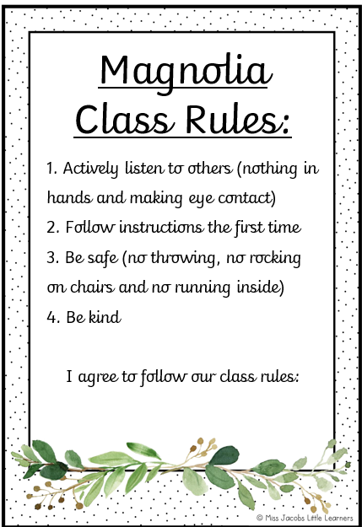
Our Class Rules:

Slide 3
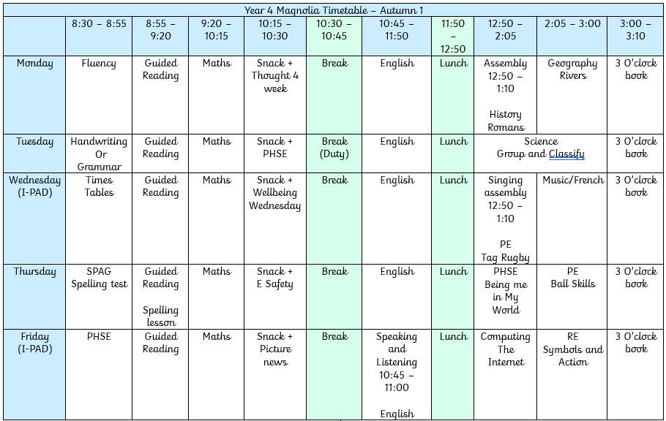
Our timetable

Slide 4
Homework
Home Learning |  | Date
Tick the home learning you have completed
Reading |  | Times tables
Learning spellings |  | Learning task
Learning Task –Maths
Handed out on Friday and returned on Tuesday.
All completed using pencil.
No longer than 20 minutes to complete the main task.
Children to tick which task they have completed.
Please let us know if there are any difficulties

Slide 5
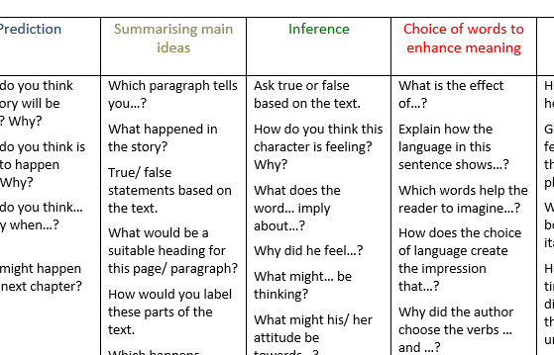
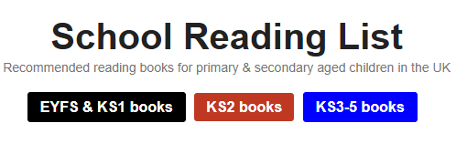


Reading expectations
  Please read to and with your child 5 times a week.
  Skills to focus on:
  Reading fluently
  Summarising
  Retrieval
  Guessing meaning of unfamiliar words
  Inferences
  Please
  use your local library
  model the above skills when you read at home.

Slide 6



Slide 7
Spellings and Writing
The spelling rule is key, not just the spelling words.
We add extra words into the test that follow the pattern taught. This is to support the children to apply the rule outside of their test.
We want children to be independent writers using nouns, noun phrases, conjunctions, prepositions and full sentences.
We want children to use joined handwriting, paying attention to capital letters, commas and full stops.

Slide 8
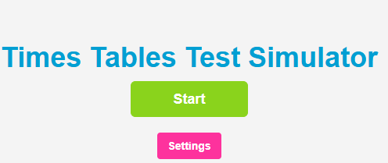


Multiplication tables
National expectations for end of Year 4:
To recall multiplication and division facts for all times tables up to 12
Children confident to solve multiplication and division questions in lots of different contexts, not just for the test.
Multiplication Check:
Online test
June
20 questions
6 seconds per question
36 = ? X 3

Slide 9

Out of school achievements
Please send in a photo of your child with a medal / certificate to share with the class.
This will go on the communal display board (if the children are comfortable with this).

Slide 10
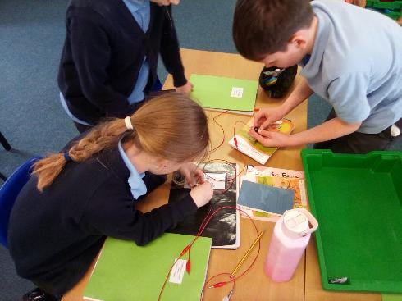
Points to remember:
Uniform –
No nail varnish
Hair tied back
Earrings out or with tape
Name on all items of clothing.
Wellies for orchard days (no walking boots)
Stationery shop:
Please make sure your child knows how much money they are bringing in and what they plan to buy.
We will send home the price menu when the shop starts.

Slide 11
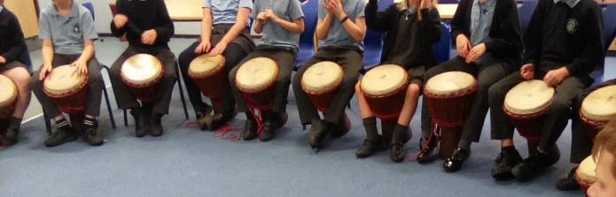
Curriculum Enrichment
We are aiming to offer:
Autumn:
Class trip – Verulamium Museum St Albans
Spring/Summer:
Drumming - Djembe
Local area visit
Outdoor learning
Cooking on a fire Den building Knot tying | Conservation and observation Compass and map direction Using tools safely

Slide 12
Thank you!
Thank you for coming!
If you have any concerns or queries, please arrange a meeting via the school office.
Please do not hesitate to speak with us on the playground after school.
Any questions?

