Slide 1
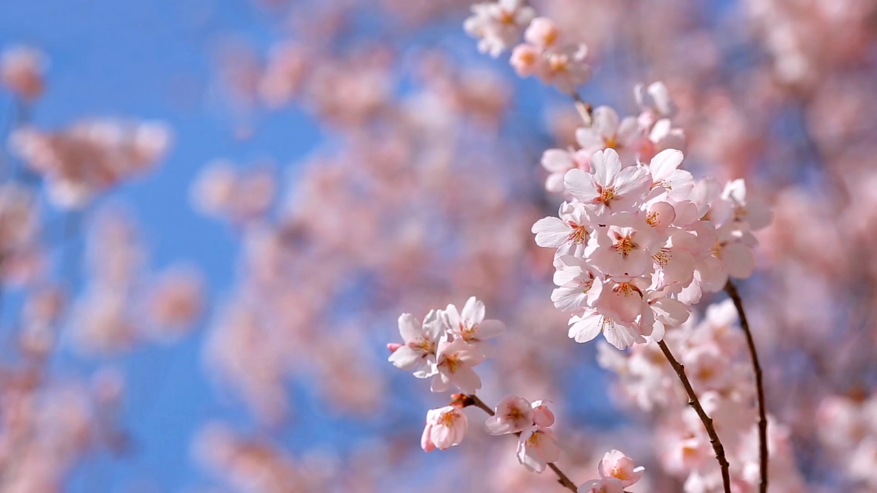
Year 3
Miss Richards and Mrs. Vallory

Slide 2

Included in this presentation:
Curriculum expectations of Year 3 – Reading, writing and maths.
How you can help at home.
Homework
Spellings and reading
Enrichment in Year 3

Slide 3
Curriculum overview
Autumn
Spring
Summer
Science –Skeletons, Movement & Nutrition
History – Stone Age, Bronze Age & Iron Age
Geography – Mountains: Alps and Cairngorm
R.E - Beliefs and Practices – Islam & Christianity
Computing – Networks & Animation
Food Technology – Making Bread
Science –Fossils, Soils & light
History – Egyptians
Geography – Coasts: Greece & Southend
R.E– Sources of Wisdom & Symbols
Computing – Sound & Databases
Art – Texture
Science – Plants, Forces & Magnets
R.E – Responsibilities & Values, Ultimate
Questions
Computing – Desktop publishing & Coding
Art – Batik
DT – Levers & Linkages

Slide 4
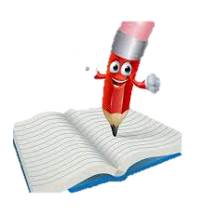
Curriculum Expectation of Year 3 -Writing
Write simple sentences using taught punctuation
Using diagonal and horizontal strokes to join letters consistently (they will be achieving their pen licence this year).
Use rich vocabulary and a range of sentence structures
Proof-read for spelling and punctuation errors
Write narratives, creating settings, characters and plot
Use organisational devices in non-narrative material (headings, subheadings)
Using conjunctions, adverbs and prepositions
Use of apostrophes and speech marks.
Spell most common exception words, words from previous year groups, and some words from the year 3/4 spelling list.

Slide 5
Curriculum expectation of Year 3- Writing
What can you do at home to help?
When completing writing homework, encourage your child to use their phonic knowledge independently to help them spell.
Remind them to use their capital letters, full stops and finger spaces.
Encourage your child to write neatly on the line, with letters that are the correct size in relation to each other.
Remind your child to use correct punctuation. (Aa . ! ? , ‘ “” )
Practise their weekly spellings with them at home!

Slide 6
Expectations of handwriting
In Year 3 your child may begin to write with a pen.
To move from pencil to pen your child needs to:
Correctly form all of their letters with cursive links.
Have consistently joined letters in all books.
Show consistent letter size.
Maintain neat handwriting in all books.
Should your child move to pen and not maintain their joined letters after a few attempts, in discussion with the teacher they will use pencil again for a while.
Pencil offers better friction on the page for the child to practise their joining.
Once consistent again, your child will move back to use pen.

Slide 7

Curriculum Expectation of Year 3 - Maths
Recognise place value in 3-digit numbers
Add and subtract numbers with up to three digits (formal methods)
Estimate answers and use inverse operations to check answers.
Count from 0 in multiples of 4, 8, 50 and 100
Use multiplication and division facts for the 3, 4 and 8 times tables.
Compare, order, add and subtract unit and non-unit fractions

Slide 8
Curriculum expectation of Year 3 - Maths
Measure, compare, add and subtract lengths, mass, volume/capacity.
Add and subtract amounts of money to give change
Tell the time from an analogue clock, including using Roman numerals, and 12-hour and 24-hour clocks.
Estimate and read time to the nearest minute.
Find the perimeter of shapes.
Identify right angles, recognise that two right angles make a half turn, three make three quarters of a turn and four a complete turn.
Identify horizontal and vertical lines and pairs of perpendicular and parallel lines.
Interpret and present data using bar charts, pictograms and tables.

Slide 9
Curriculum Expectation of Year 3 - Maths
What can you do at home to help?
Practise 3-, 4- and 8-times tables at home. (make sure they already know their 2’s, 5’s and 10s).
Encourage your child to read the time on a clock to the nearest hour and 15 minutes.
Ask your child to show you a number and tell you how many hundreds, tens and how many ones.
Encourage your child to notice 3D shapes in real life and name the shape and describe its properties (e.g. edges, faces, vertices)
Encourage your child to notice fractions in real life (e.g. cutting up a pizza).

Slide 10

Curriculum expectation of Year 3- Reading
Continue reading exception words and noting the unusual parts.
Apply growing knowledge of root words, prefixes and suffixes.
Use dictionaries to check meaning
Read a wide range of books fiction, non-fiction, myths, legends, poetry and scripts.
Check the text makes sense to them, discuss their understanding and explain the meaning of words
Draw inferences of characters’ feelings, thoughts and motives
Identify main ideas from paragraphs and summarise them
Participate in discussions about books they have read and books that are read to them

Slide 11
Curriculum expectation of Year 3 - Reading
What can you do at home to help…?
Practise reading at least 5 times a week.
Ask your child questions about the text.
Look to see what our weekly focus in guided reading is
Record in the reading record.

Slide 12
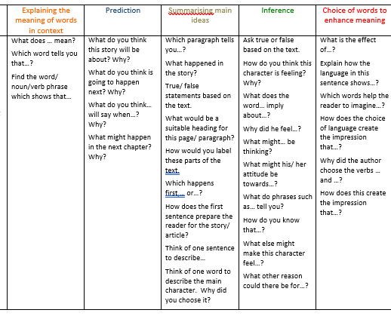
Spellings and Reading
Please practise the spellings set each week. They are set on a Thursday and tested on the following Thursday.
Please read with your child every evening and record this in their reading record.
Please try to focus any questions on the Guided Reading focus that week by using the question stems at the front of the reading record.

Slide 13
Homework
Set on a Friday and returned on a Tuesday.
The homework will be a maths, literacy or subject based piece of learning. This will either be pre-learning or consolidation of learning from the week.
It should no longer than 20 minutes to complete, unless more time is given in a bigger project.
If your child is finding an element of the homework tricky. Do not worry. Return the homework and a teacher will help your child in school.
Practise 2,5,10,3,4,8 times tables (we will assess these weekly next term)

Slide 14
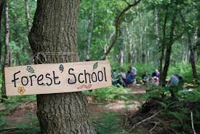
Enrichment Reminder
Enrichment opportunities coming up!
Autumn Term
Orchard – Forest school learning days (Wellies MUST be worn!)
Mosque Visit – (Rough Cost £15)
Spring Term
Ancient Egypt Workshop (Rough Cost £15)
Orchard – Forest school learning days
Summer Term
Orchard – Forest school learning days
Swimming (Rough Cost £105)

Slide 15

Things to remember…
P.E will be taught Tuesday and Friday afternoons.
Importance of attendance
If your child is absent this breaks the continuity of learning, and they could find it trickier to access the learning.
Support your child
Please read everyday! Reading underpins everything that we do in school.
Outside achievements
We love to hear about your child’s achievements outside of school, however we do not do a show and tell as this uses up valuable learning time. Your child can share this with adults and their friends during the day.

Slide 16

Any questions?

