Slide 1

Year 2
Miss Buckley and Miss Makin

Slide 2

Included in this presentation:
Curriculum expectations of Year 2 Writing
Curriculum expectations of Year 2 Maths
Curriculum expectations of Year 2 Reading
How you can help at home. Homework
Spellings and reading
Standardised assessments
Enrichment in Year 2

Slide 3
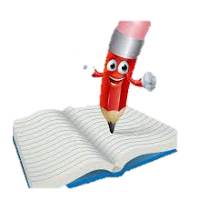
Curriculum expectation of Year 2- Writing
This may seem like a lot… but your child works to achieve this across the year!
What can you do at home to help…?
When completing writing homework encourage your child to use their phonic knowledge to help them spell.
Remind them to use their finger spaces.
Encourage your child to write neatly on the line, with letters that are the correct size in relation to each other.
Remind your child to use correct punctuation.
Practice weekly spellings.

Slide 4

Curriculum expectation of Year 2 - Maths
By the end of Year 2, to be age related your child needs to be able to:
Recall all number bonds to 10 and 20
Partition any two-digit number into different combinations of tens and ones,
Add and subtract any 2 two-digit numbers using an efficient strategy.
Recall multiplication and division facts for 2, 5 and 10 and use them to solve problems
Read scales in divisions of ones, twos, fives and tens
Identify fractions of a number or shape
Use different coins to make the same amount
Read the time on a clock to the nearest 15 minutes
Name and describe properties of 2-D and 3-D shapes, including number of sides, vertices, edges, faces and lines of symmetry.

Slide 5
Curriculum expectation of Year 2 - Maths
This may seem like a lot… but your child works to achieve this across the year!
What can you do at home to help…?
Children must be forming numbers correctly.
Practise 2,5 and 10 times table at home – build fluency with speed.
Support with reading the time on a clock to the nearest 15 minutes.
Practise number bonds to 10 and the related facts to 20 and to 100.
Ask your child to show you a number and tell you how many tens and how many ones.
Try counting change in your purse/wallet with them.

Slide 6

Curriculum expectation of Year 2- Reading
By the end of Year 2, to be age related your child needs to be able to:
Read accurately most words of two or more syllables
Read most words containing common suffixes (-ful, -less, -ly)
Read most common exception words
Read most words accurately without overt sounding and blending
Check it makes sense to them, correcting any inaccurate reading
Answer questions and make some inferences
Explain what has happened so far in what they have read.

Slide 7
Curriculum expectation of Year 2 - Reading
This may seem like a lot, but your child works to achieve this across the year!
What can you do at home to help…?
Practise reading at least 5 times a week.
During your reading sessions at home focus on: Vocabulary, prosody and comprehension – spread these throughout the week. (this will change for coloured book bands).
Ask your child questions about the text.
Record your session in the reading record.
If your child has focus sounds, please also practise these at home!

Slide 8
Homework
Set on a Friday and returned on a Tuesday.
The homework will be either based on maths or literacy. This will be consolidation of learning from the week.
For the literacy homework your child will be asked to write 3 or 4 sentences containing the spelling words for that week.
It should take your child no longer than 20 minutes to complete.
If your child is finding an element of the homework tricky. Do not worry. Return the homework and a teacher will help your child in school.

Slide 9
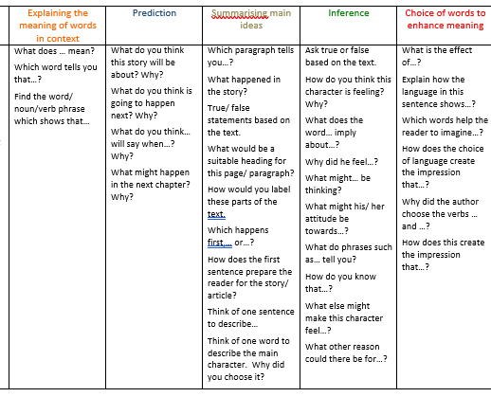
Spellings and Reading
Please practise spellings set each week on a Thursday. They are tested the following Wednesday.
Please read with your child every evening and record this in their reading record.
Please try to focus questioning on the Guided reading focus that week by using the question stems at the front of the reading record (purple band upwards).
While your child is reading phonically decodable books, they will have 3 guided sessions with a trained adult.
Your child will receive their new phonic book for the week on a Monday.

Slide 10
End of KS1 standardised assessment
You may have heard that the SATS for Year 2 are now optional for schools.
At the end of Year 2 we will continue to assess your child with standardised assessments, but this again is only to inform our teaching assessment of your child for entering KS2.

Slide 11
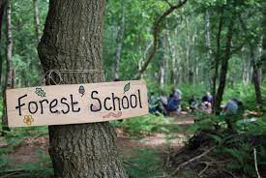
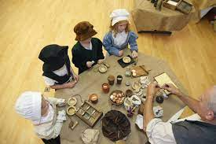
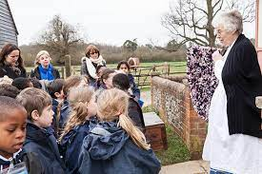
Enrichment Reminder
Autumn Term
Great Fire of London day –Tuesday 14th October – Please do offer to help if you can!
Orchard – Thursday 25th September 2025 – What to bring!?
Bring in welly boots
Come into school in non-school uniform but wear school shoes.
Spring Term
Orchard - Forest school learning days.
Summer Term
- Chiltern open air museum – Link to Florence Nightingale
- Orchard – Forest school learning days
We cook with your child throughout the year – please ensure children have an apron.
All allergy consent has been given through arbor, please update the school office if there are any
changes regarding allergy requirements.

Slide 12

Things to remember…
Importance of attendance!
If your child is absent this breaks the continuity of learning, and they could find it trickier to access the learning.
Support your child!
Please read every day! Reading underpins everything that we do in school.
Outside achievements!
We love to hear about your child’s achievements outside of school, however we do not do a show and tell as this uses up valuable learning time. Your child can share this with adults and their friends during the day.

Slide 13

Any questions…?

