Slide 1

Year 1
Mrs Scott and Miss Birch

Slide 2

Included in this presentation:
Curriculum expectations of Year 1 Reading
Curriculum expectations of Year 1 Writing
Curriculum expectations of Year 1 Maths
How you can help at home. Homework
Reading
Phonics screening
Enrichment in Year 1

Slide 3
Reading expectations
The pupil can:
• read accurately many words of two or more syllables containing graphemes taught
so far1
for all of the 40+ phonemes
• read most words containing common Year 1 suffixes*
• read most Year 1 common exception words*
In age-appropriate1 books, the pupil can:
• read most words accurately without frequent overt sounding and blending, and
sufficiently fluently to allow them to focus on their understanding rather than on
decoding individual words
• sound out most unfamiliar words accurately
In a book they can already read fluently, the pupil can:
• check that it makes sense to them, correcting most inaccurate reading
• answer questions and make some inferences
• join in discussions about what has happened so far in what they have read

Slide 4

Reading
What can you do at home to help…?
Practise reading at least 5 times a week.
During your reading sessions at home focus on: Vocabulary, prosody and comprehension – spread these focuses throughout the week.
Ask your child questions about the text.
Record your session in the reading record.
If your child has focus sounds, please also practise these at home!
Guided Reading happens three days a week. Each child reads to an adult three times a week.
Books go home on a Monday and then need to be returned back to school the following Monday.
Use the reading prompts at the beginning of the Reading Record to support with daily reading at home.

Slide 5
Writing expectations
The pupil can, after discussion with the teacher:
• read own writing aloud clearly for others to hear and discuss
• orally rehearse sentences and sequence them to form short narratives
• join words and clauses with the conjunction ‘and’
• use past, present and future accurately in speech and begin to incorporate these in their
writing
• demarcate many sentences using a capital letter and a full stop, question mark or
exclamation mark
• spell some Y1 common exception words* and the days of the week
• segment spoken words into phonemes and represent these by graphemes, spelling many
words in a phonically-plausible way
• form many letters and digits correctly, with some difference between upper and lower-case
letters
• use spaces between words.

Slide 6

Writing
What can you do at home to help…?
Check correct letter formation
Simple sentences- encourage your child to write
Finger spaces
Writing on the line
Pencil grip- Pinch, Flick, Write

Slide 7
Maths expectations
Number and place value Counts to and across 100, forwards and backwards, beginning with 0 or one, or from any given number Counts, reads and writes numbers to 100 in numerals; counts in multiples of twos, fives and tens Given a number, identifies one more and one less Addition and subtraction Represents and uses number bonds and related subtraction facts within 20 Fractions (including decimals) Recognises, finds and names a half as one of two equal parts of an object, shape or quantity Measurement Compares, describes and solves practical problems for: 1. lengths and heights eg long/short, longer/shorter, tall/short, double/half; 2. mass/weight eg heavy/light, heavier than, lighter than; 3. capacity and volume eg full/empty, more than, less than, half, half full, quarter; and 4. time eg quicker, slower, earlier, later. Tells the time to the hour and half past the hour and draws the hands on a clock face to show these times Properties of shape Recognises and names common 2-D and 3-D shapes, including: 1. 2-D shapes eg rectangles (including squares), circles and triangles; 2. 3-D shapes eg cuboids (including cubes), pyramids and spheres.

Slide 8

Maths
What can you do at home to help…?
Check number formation
To count forwards and backwards to 20
Use the words less than, greater than, equal to when comparing numbers.

Slide 9
Curriculum
Daily phonics
Daily reading
Daily writing and maths
Forest school days once a term
Animals UK, local walk, Lea Valley science trip, outdoor learning trip, and RE visits
Attendance is vital to progress and to your child’s confidence in school.

Slide 10
Homework
Set on a Friday and returned on a Tuesday.
The homework will be a maths, literacy or subject based piece of learning. This will either be pre-learning or consolidation of learning from the week.
It should take your child no longer than 20 minutes to complete, unless more time is given for example in a bigger project.
If your child is finding an element of the homework tricky. do not worry. Return the homework and a teacher will help your child in school.

Slide 11
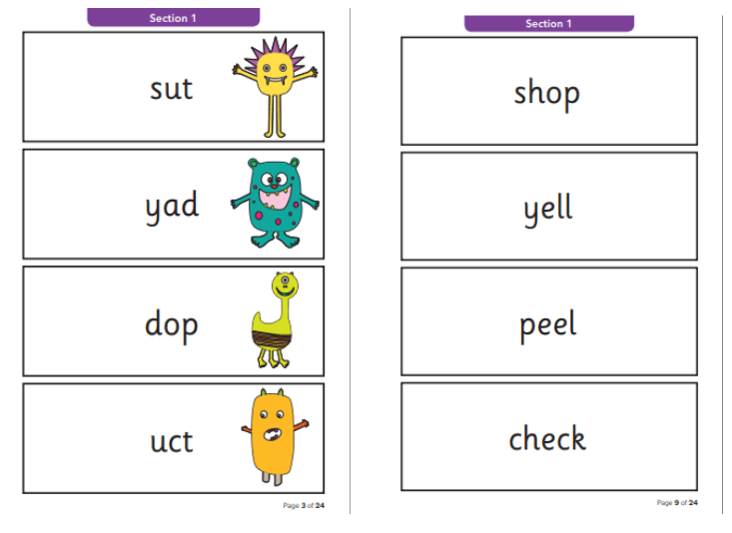
Yr 1 Phonics screening
The Yr 1 phonics screening will take place W/C 8th June 2026
We will be practicing reading phase 3 to 5 phonemes in class.
The screening consists of both real words and alien words.
The children are asked to segment the words into their sounds and then blend them together to read the word.
There are lots of phonic games apps that the children can play at home to support their recognition of phase 3 to 5 phonemes.

Slide 12

Diary dates- Autumn term
15th October- Local Walk
21st October and 23rd October – learning reviews
22nd October- Animal workshop
24th October – outdoor learning day

Slide 13
Finally….
Independence is key! Getting dressed, remembering water bottles, carrying their own bags.
PE Birch- every Monday and Tuesday Beech – every Monday and Friday – see PE kit requirements on website.
PLEASE PLEASE label everything – they all look the same.
When collecting your child, please wait for them to be called, do not call them yourself.
Water bottles every day.
READ READ READ READ!

