Slide 1
Teach reading: change lives
Parent workshop: Phonics and early reading

Slide 2
A love of reading is the biggest indicator of future academic success.
OECD (The Organisation for Economic Co-operation and Development)

Slide 3


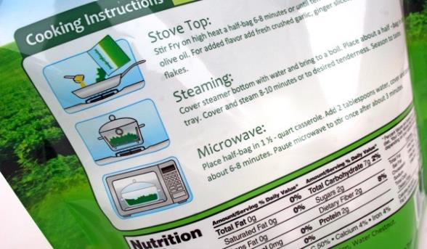
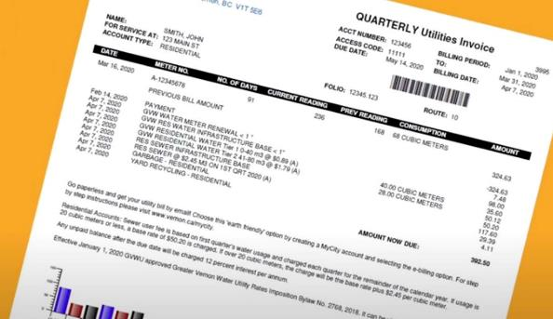

Slide 4

Phonics

Slide 5

Little Wandle Letters and Sounds Revised
Our school has chosen
Little Wandle Letters and Sounds Revised as our systematic, synthetic phonics (SSP) programme to teach early reading and spelling.

Slide 6
Phonics is:
making connections between the sounds of our spoken words and the letters that are used to write them down.

Slide 7
Terminology
Phoneme
Blend
Grapheme
Segment
Digraph
Split vowel digraph
(a_e → cake)
Trigraph

Slide 8

Blending to read words
Notes:
https://www.littlewandlelettersandsounds.org.uk/resources/for-parents/

Slide 9
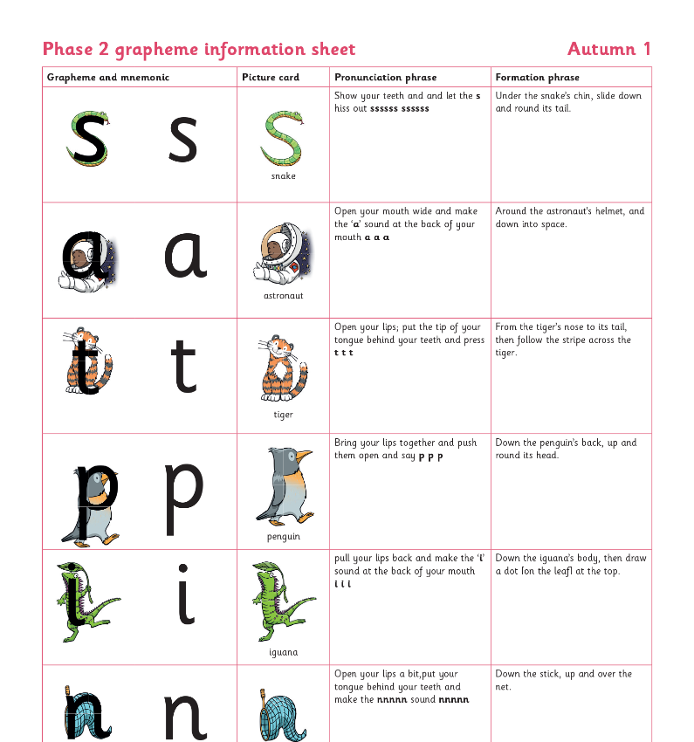
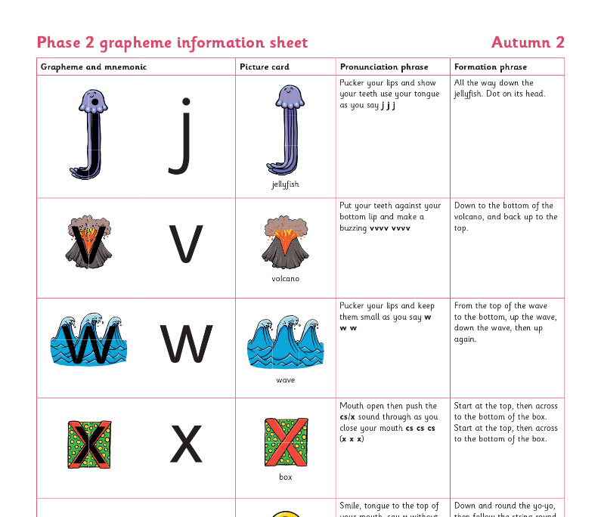
Teaching order

Slide 10
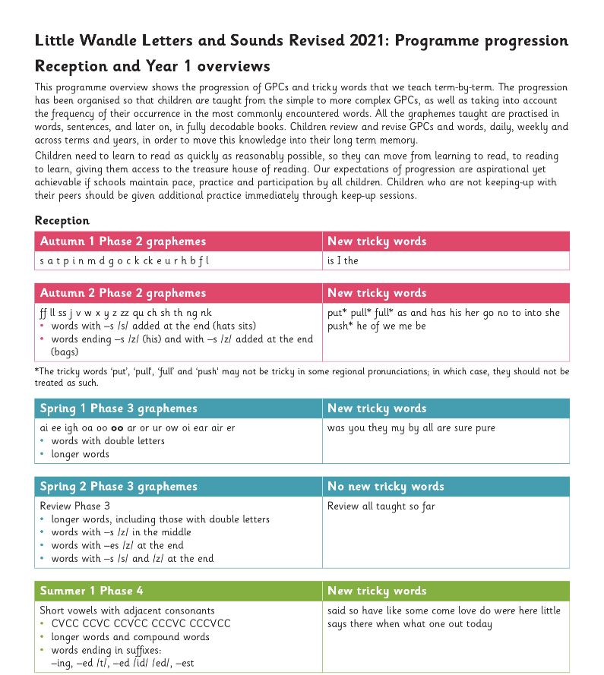
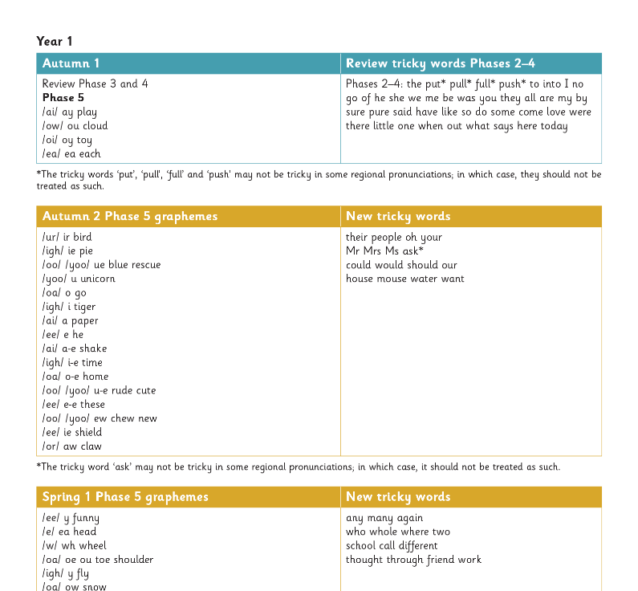
Gradually your child learns the entire alphabetic code:

Slide 11




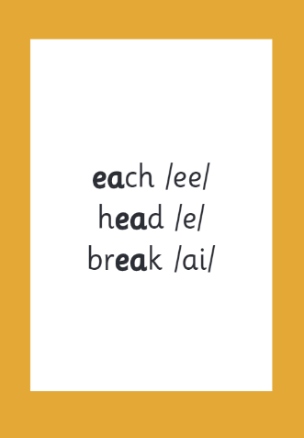

How we make learning stick
when

Slide 12
Reading and spelling

Slide 13
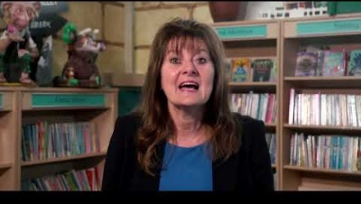
Tricky words
Notes:
https://www.littlewandlelettersandsounds.org.uk/resources/for-parents/

Slide 14

Spelling
Say the word.
Segment the sounds. (Robot talk)
Count the sounds.
Write them down.

Slide 15


Reading and spelling

Slide 16
And all the different ways to write the phoneme sh:
shell
chef
special
caption
mansion
passion

Slide 17
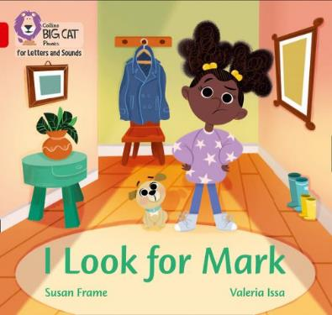
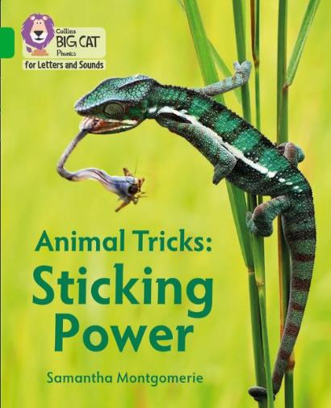
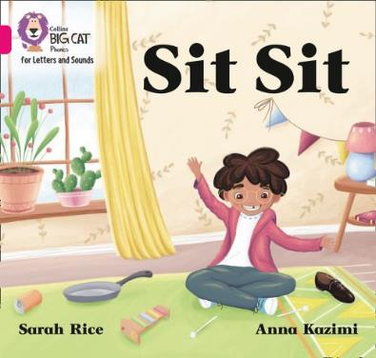
How do we teach reading in books?
Reading practice sessions are:
timetabled three times a week
taught by a trained teacher/early years practitioner
taught in small groups.

Slide 18
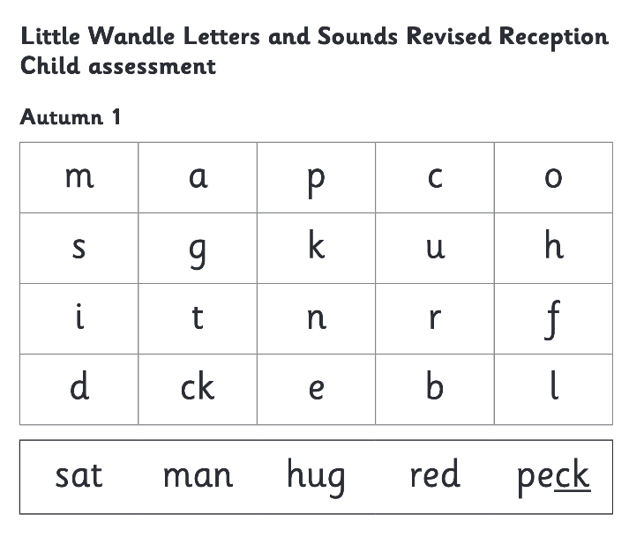

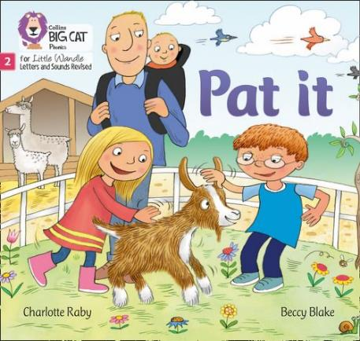

We use assessment to match your child the right level of book

Slide 19
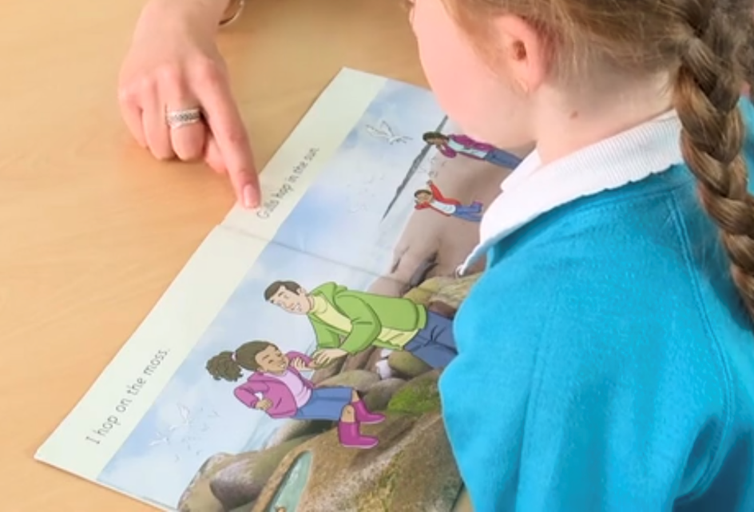
Reading a book at the right level
This means that your child should:
Know all the sounds and tricky words in their phonics book well
Read many of the words by silent blending (in their head) – their reading will be automatic
Only need to stop and sound out some of the words by the time they bring the book home – but they should be able to do this on their own.

Slide 20
Reading at home

Slide 21
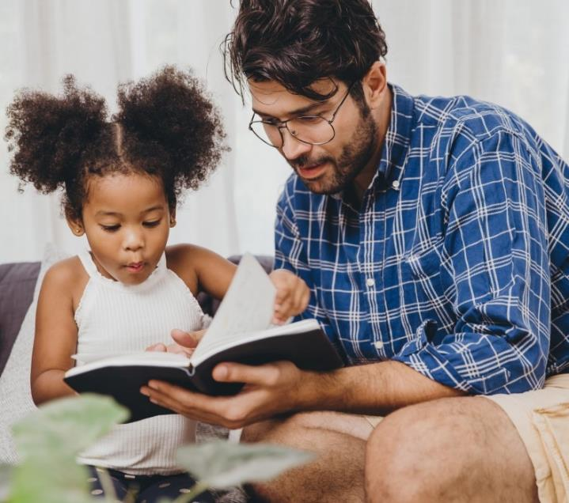
The most important thing you can do is read with your child
Reading a book and chatting had a positive impact a year later on children’s ability to…
understand words and sentences
use a wide range of vocabulary
develop listening comprehension skills.
The amount of books children were exposed to by age 6 was a positive predictor of their reading ability two years later.
Parental involvement in the development of children’s reading skills: A five-year longitudinal study (2002) Senechal, M. and Lefvre, J

Slide 22

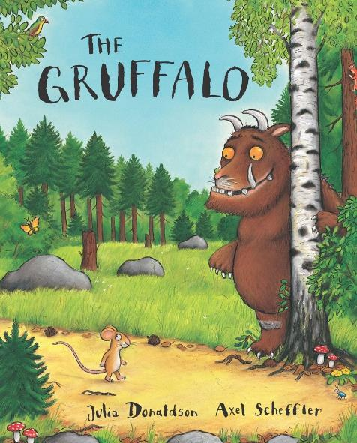
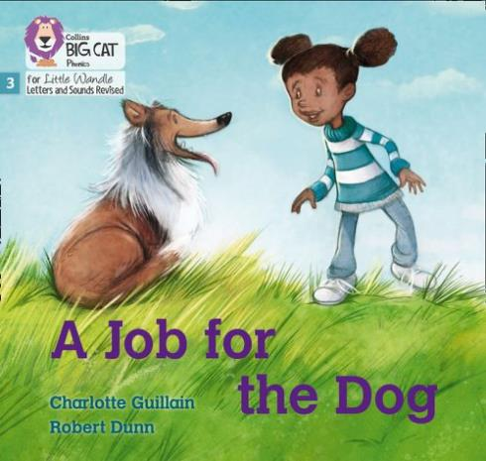
Books going home

Slide 23

Read to your child
The shared library book is for YOU as adults to read:
Make the story sound as exciting as you can by changing your voice.
Talk with your child as much as you can:
  Introduce new and exciting language
  Encourage your child to use new vocabulary
  Make up sentences together
  Find different words to use
  Describe things you see.

Slide 24
Listening to your child read their phonics book
Your child should be able to read their book without your help.
If they can’t read a word, encourage them to sound it out and blend it together.
Talk about the book and celebrate their success.

Slide 25
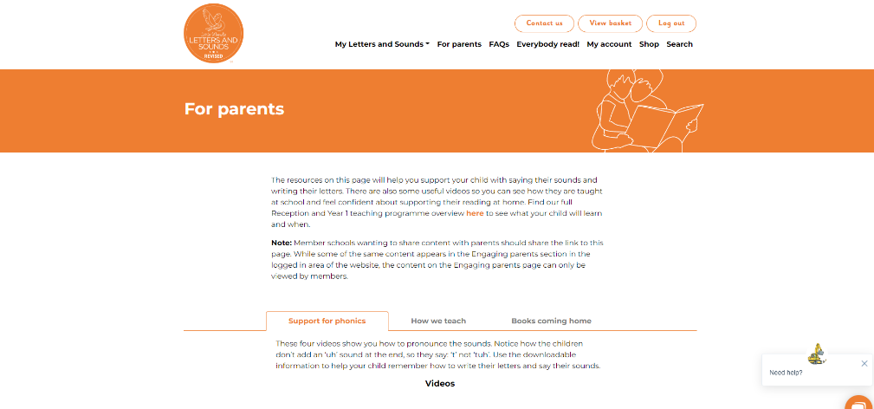
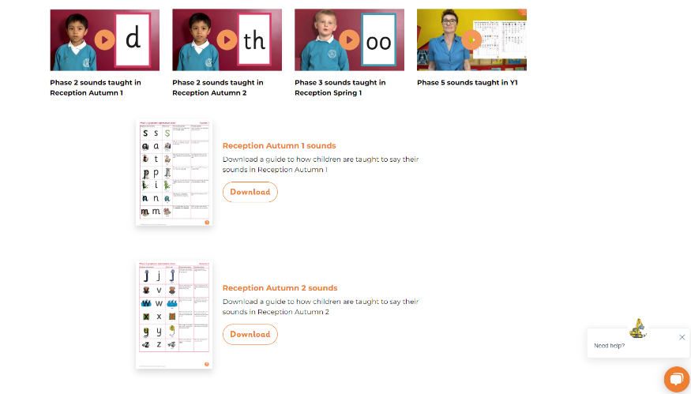
Supporting your child with phonics
Notes:
https://www.littlewandlelettersandsounds.org.uk/resources/for-parents/

Slide 26
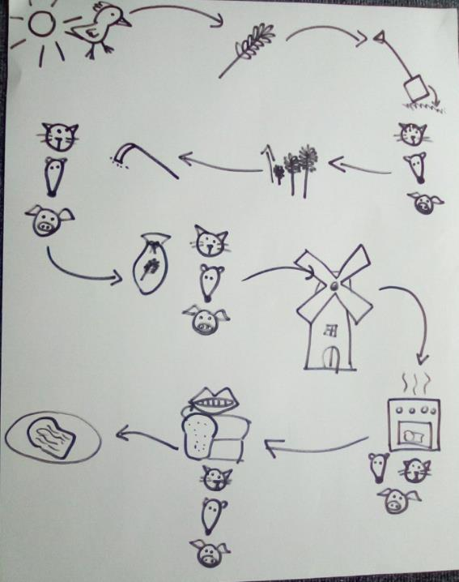
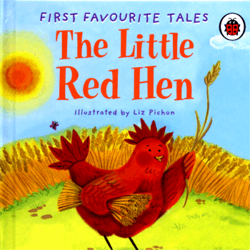
Talk4Writing
A way to learn story language, story structure and be able to tell our own stories.
Retelling
Recording and story mapping
Changing details of the story to make up our own (but ‘magpie’ story language)

Slide 27
One of the greatest gifts adults can give is to read to children
Carl Sagan

